Slide 1
PI
Lucas augusto HARTMANN

Slide 2
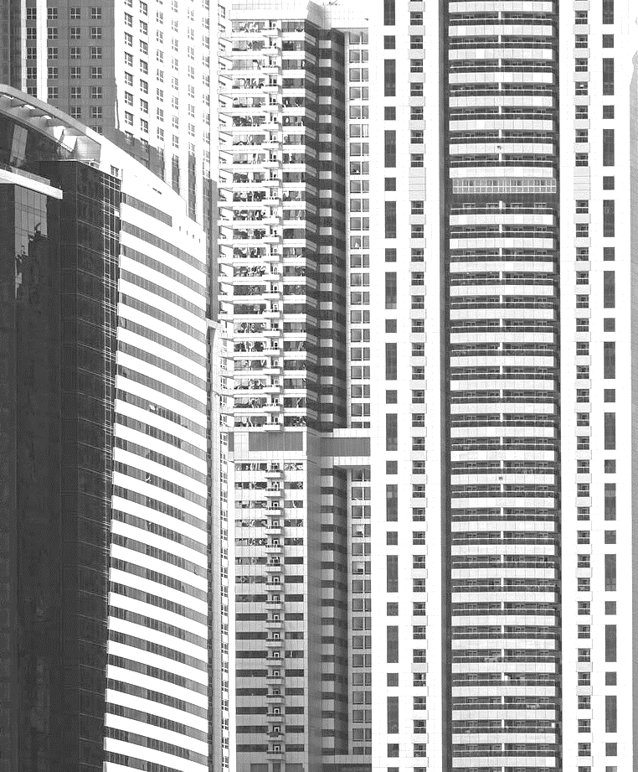

Sumario
Introdução
Sobre o projeto
Porque
Publico alvo
objetivo
Linha do tempo
Conclusao/resume
Próximos passos

Slide 3
Introducão
Lucas Augusto Hartmann, 22 Years Old
Enrolled at Senac, studying System Development Course
I study programming since 2020

Slide 4
Sobre o projeto
System for a Real State Company / Real State Software
Create, Read, Update, Delete
Clients, Real State like Apartaments, Stores, Lofts, Houses, Deposits.
Info about the Businness: how much Money did make this month, this year... How many clients has, how many workers has

Slide 5
Por que
Software that I use for my work has flaws
Relatives that are freelance or owns a company
Product: consultat, he has clientes, he wants to know about his company

Slide 6
objetivo
Gain experience
Use my experience to Try to build a better software that I work with, or at least my software, with my design choices
Build my best software yet
Impress companies

Slide 7
Publico alvo
Real State Business
Any company because my software can adapt or i can can create another
Freelancers
People that own a company

Slide 8
Tecnologias usadas
Real State Business
Any company because my software can adapt or i can can create another
Freelancers
People that own a company

Slide 9
Diagramas
Real State Business
Any company because my software can adapt or i can can create another
Freelancers
People that own a company

Slide 10
Telas
Real State Business
Any company because my software can adapt or i can can create another
Freelancers
People that own a company

Slide 11
TIMELINE
MAY 2025 | Did more diagrams and designs thinking about the interface of the software
JUL 2025 | Started doing the interface
AUG 2025 | Designed the database, based on the diagrams that I did before
SEP 2025 | Started doing the database, conecting with the code, and did more interface
OCT 2025 | More Interface
NOV 2025 | More Interface
NOV 2024 | Decided the subject of the Integration Project
DEC 2024 | Decided what would be the classes of my project
FEB 2025 | Did some diagrams to plan better
MAR 2025 | Started to do the code. Starting with models classes
APR 2025 | More coding

Slide 12
Resume
ss

Slide 13
Next Steps
Interface
Build a better interface. More pretty and with a better user interface
Code
Make the code more readable and more efficient. Cleanup the code
Documentation
Complete the documentation. Do the esquemas do br modelo

Slide 14
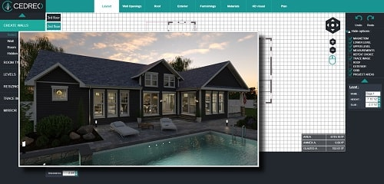

Thank you
Lucas Augusto Hartmann
Lucashartmann
Qrcode linkedin

